Slide 1
Inter Process Communication

Slide 2
Interprocess Communication
Processes executing concurrently in the operating system may be either independent processes or cooperating processes.
A process is independent if it cannot affect or be affected by the other processes executing in the system.
Any process that does not share data with any other process is independent.
A process is cooperating if it can affect or be affected by the other processes executing in the system.
Clearly, any process that shares data with other processes is a cooperating process.

Slide 3
Reasons for Process Co-operation
Information sharing: Since several users may be interested in the same piece of information (for instance, a shared file), we must provide an environment to allow concurrent access to such information.
Computation speedup: If we want a particular task to run faster, we must break it into subtasks, each of which will be executing in parallel with the others. Such a speedup can be achieved only if the computer has multiple processing elements (such as CPUs or I/O channels).
Modularity: We may want to construct the system in a modular fashion, dividing the system functions into separate processes or threads
Convenience: Even an individual user may work on many tasks at the same time. For instance, a user may be editing, printing, and compiling in parallel.

Slide 4
IPC Mechanisms
Shared Memory
Pipes
Unnamed pipes – pipe() for related process like parent, child, grand child - unidirectional
Named pipes – mkfifo() or mknod() for unrelated process – bidirectional communication
Message Passing
Signals
Sockets

Slide 5
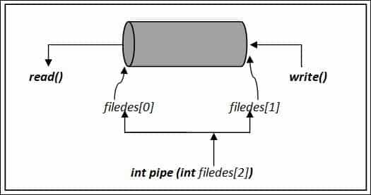
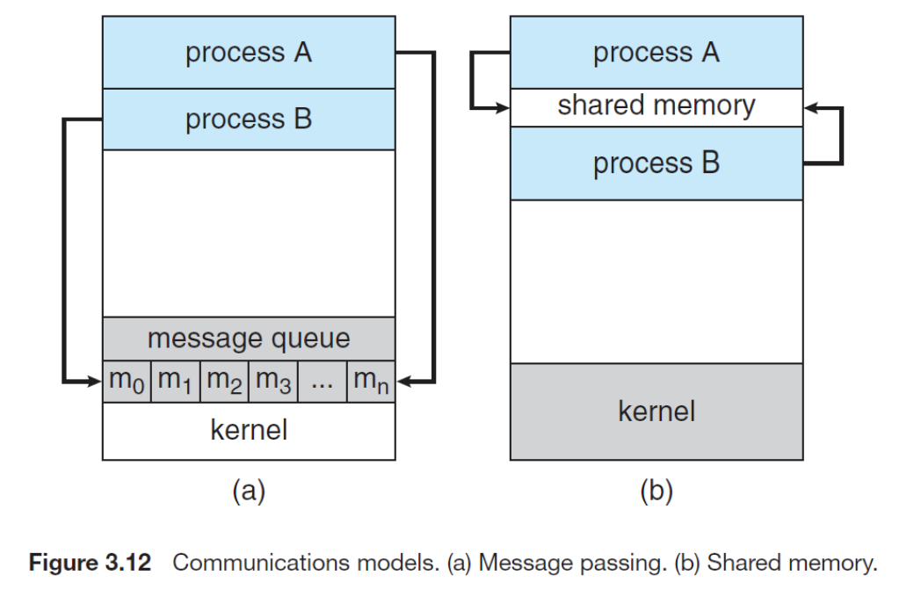
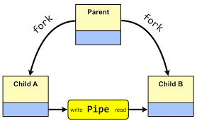
Communication Models

Slide 6
Interprocess Communication
Cooperating processes require an interprocess communication (IPC) mechanism that will allow them to exchange data and information.
Let us consider the two fundamental models of interprocess communication:
shared memory
message passing
In the shared-memory model, a region of memory that is shared by cooperating processes is established.
Processes can then exchange information by reading and writing data to the shared region.
In the message-passing model, communication takes place by means of messages exchanged between the cooperating processes.

Slide 7
Interprocess Communication
Message passing is useful for exchanging smaller amounts of data, because no conflicts need to be avoided.
Message passing is also easier to implement than shared memory for inter-computer communication.
Shared memory allows maximum speed and convenience of communication, as it can be done at memory speeds when within a computer.
Shared memory is faster than message passing, as message-passing systems are typically implemented using system calls and thus require the more time-consuming task of kernel intervention.
In contrast, in shared-memory systems, system calls are required only to establish shared-memory regions.
Once shared memory is established, all accesses are treated as routine memory accesses, and no assistance from the kernel is required.

Slide 8
Shared-Memory Systems
Interprocess communication using shared memory requires communicating processes to establish a region of shared memory.
Typically, a shared-memory region resides in the address space of the process creating the shared-memory segment.
Other processes that wish to communicate using this shared-memory segment must attach the shared memory to their address space.

Slide 9
Shared-Memory Systems
Processes can then exchange information by reading and writing data in the shared areas.
The form of the data and the location are determined by these processes and are not under the operating system's control.
The processes are also responsible for ensuring that they are not writing to the same location simultaneously.
To illustrate the concept of co-operating processes, let us consider the producer-consumer problem.

Slide 10
Producer Consumer Problem
A producer process produces information that is consumed by consumer process.
For example, compiler code makes assembly code consumed by an assembler. A Web server produces HTML, images, etc., and client computers consume the information through the browser.
The producer-consumer problem can be solved by a shared memory region.
We must have a buffer of items that is filled by a producer and the buffer emptied by the consumer.
The buffer resides in the shared memory region.
The producer and the consumer must be synchronized.
While producer creates an item, the consumer consumes another item and not try to consume something not yet created.

Slide 11
Producer Consumer Problem - The Buffer
The buffer can be of two types:
Unbounded buffer
Bounded buffer
Unbounded buffer
There is no limit on the size of the unbounded buffer.
The consumer waits for a new item, however, there is no restriction on the producer to produce items.
Bounded buffer
If the buffer is empty, the consumer must wait for a new item.
When the buffer is full, the producer waits until it can produce new items.

Slide 12
Producer Consumer Problem - The Buffer
Let us see how bounded buffer is implemented. A bounded buffer is implemented using a circular queue of an array.
#define BUFFER_SIZE 10
typedef struct
{
......
} item;
item buffer[BUFFER_SIZE];
int in = 0;
int out = 0;

Slide 13
Producer Consumer Problem - The Producer
Consider the producer and consumer code below. The buffer is empty when in == out. The buffer is full when ((in + 1) % BUFFER_SIZE) == out;
Producer
item nextProduced;
while (true)
{
/* produce an item in nextProduced */
while(((in + 1)% BUFFER_SIZE) == out)
; /* do nothing */
buffer[in] = nextProduced;
in = (in + 1) % BUFFER_SIZE;
}

Slide 14
Producer Consumer Problem - The Consumer
Consumer
item nextConsumed;
while(true)
{
/* consume an item in nextConsumed */
while(in == out)
; /* do nothing */
buffer[out] = nextConsumed;
out = ( out + 1) % BUFFER_SIZE;
/* consume the item in nextConsumed */
}
The buffer contains BUFFER_SIZE - 1 items in the above implementation and no more. And no synchronized access to the shared buffer here.

Slide 15
Message Passing
Message passing provides a mechanism to allow processes to communicate and to synchronize their actions without sharing the same address space.
It is particularly useful in a distributed environment, where the communicating processes may reside on different computers connected by a network.
For example. An Internet chat program
A message passing facility provides at least two operations
send(message)
receive(message)

Slide 16
Message Passing
Messages sent by processes are of fixed size or variable size.
If processes P and Q want to communicate, they must send messages to and receive messages from each other.
The communication can be
Direct or indirect
Synchronous or asynchronous
Automatic or explicit buffering

Slide 17
Naming – Message Passing
In direct communication, each process that wants to communicate must explicitly name the recipient or sender of the communication
Eg:
send(P,message) – send a message to process P
receive(Q,message) – receive a message from process Q
Here
The link is established automatically, the processes need to know each others identity to communicate
A link is associated with exactly two processes
Between each pair of processes, there exists exactly one link

Slide 18
Naming – Message Passing
The above scheme exhibits symmetry in addressing; both sender and receiver must name each other to communicate.
A variant of the above scheme is only the sender has to name the recipient.
send(P, message)
receive(id, message) – the variable id is set to the name of the process with which communication has taken place.

Slide 19
Message Passing
In indirect communication, the messages are sent to and received from mailboxes or ports.
Each mailbox has an unique id.
send(A, message) - send a message to mailbox A
receive(A, message)- receive a message from mailbox A
Here
A link is established between pair of processes only if both the members have a shared mailbox
A link may be associated with more than two processes
Between each pair of communicating processes, a number of different links may exist, with each link corresponding to one mailbox

Slide 20
Message Passing
Suppose P1,P2 and P3 all share mailbox. P1 sends message to A, while both P2 and P3 execute a receive() from A.
Which process will receive the message from P1?
The answer depends on:
Allow a link to be associated with two processes at most.
Allow at most one process at a time to execute a receive() operation
The system may have an algorithm to select arbitrarily which process will receive the message.

Slide 21
Message Passing
A mailbox can be owned by a process or OS.
If a process which owns the mailbox terminates, the mailbox disappears
Any process subsequently sends a message to that mailbox must be notified that the mailbox no longer exists.
If mailbox owned by OS, then it is not attached to any process.
The OS must provide mechanism that allows a process to do the following
Create a new mailbox
Send and receive messages through mailbox
Delete a mailbox

Slide 22
Message Passing
The process which has created the mailbox is the owner and it can receive messages through the mailbox
But the ownership and receiving privileges can be passed on to other processes that could result in multiple receiver for each mailbox.

Slide 23
Synchronization
Communication between processes takes place through calls to send() and receive() primitives.
Message passing may be either blocking or nonblocking also known as synchronous and asynchronous.
Blocking send: the sending process is blocked until the message is received by the receiving process or by the mailbox.
Nonblocking send: the sending process sends the message and resumes operation.
Blocking receive: the receiver blocks until a message is available.
Nonblocking receive: the receiver retrieves either a valid message or a null.

Slide 24
Synchronization
The solution to the producer-consumer problem becomes trivial when we use blocking send() and receive() statements.
The producer merely invokes the blocking send() call and waits until the message is delivered to either the receiver or the mailbox.
Likewise, when the consumer invokes receive(), it blocks until a message is available.

Slide 25
Producer Consumer - Blocking send and receive

Slide 26
Buffering
Whether communication is direct or indirect, messages exchanged by communicating processes reside in temporary queue.
Such queues can be implemented in three ways:
Zero capacity: the queue has a maximum length of zero; thus the link cannot have any messages waiting in it. In this case, the sender must block until the recipient receives the message.
Bounded capacity: the queue has finite length n; thus at most ‘n’ messages can reside in it. If the queue is not full when a new message is sent, the message is placed in the queue, and the sender can continue execution without waiting. The link capacity is finite. However, if the link is full, the sender must block until space is available in the queue.
Unbounded capacity: the queue length is potentially infinite; thus any number of messages can wait in it. The sender never blocks.

